Slide 1
Chapter 28
Magnetic Fields

Slide 2
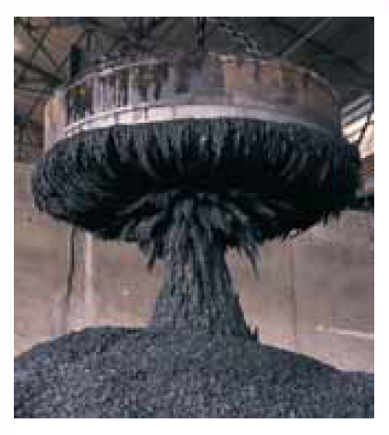
28.2: What Produces Magnetic Field?:
One way that magnetic fields are produced is to use moving electrically charged particles, such as a current in a wire, to make an electromagnet. The current produces a magnetic field that is utilizable.
The other way to produce a magnetic field is by means of elementary particles such as electrons, because these particles have an intrinsic magnetic field around them.
The magnetic fields of the electrons in certain materials add together to give a net magnetic field around the material. Such addition is the
reason why a permanent magnet, has a permanent magnetic field.
In other materials, the magnetic fields of the electrons cancel out, giving no net magnetic field surrounding the material.

Slide 3


28.3: The Definition of B:
We can define a magnetic field, B, by firing a charged particle through the point at which is to be defined, using various directions and speeds for the particle and determining the force that acts on the particle at that point. B is then defined to be a vector quantity that is directed along the zero-force axis.
The magnetic force on the charged particle, F_{B}, is defined to be:
Here q is the charge of the particle, v is its velocity, and B the magnetic field in the region. The magnitude of this force is then:
Here φ is the angle between vectors v and B.

Slide 4
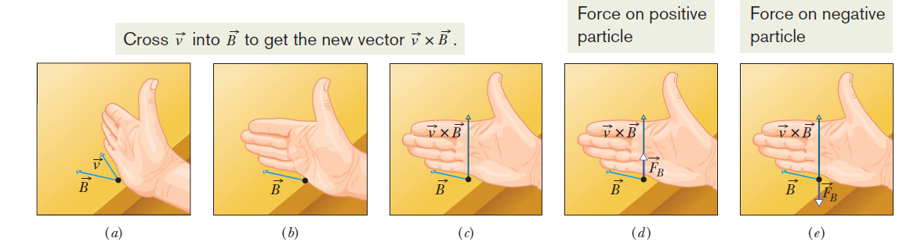
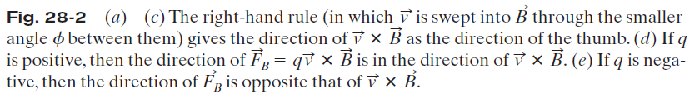
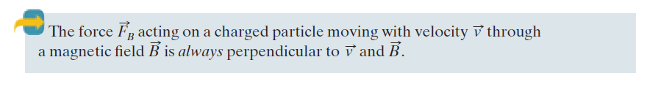
28.3: Finding the Magnetic Force on a Particle:

Slide 5
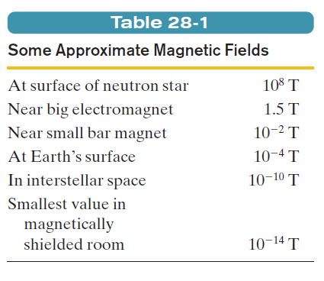

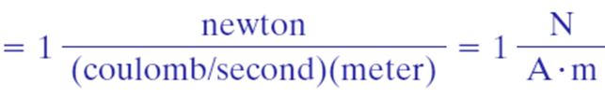

28.3: The Definition of B:
The SI unit for B that follows is newton per coulomb-meter per second. For convenience, this is called the tesla (T):
An earlier (non-SI) unit for B is the gauss (G), and

Slide 6
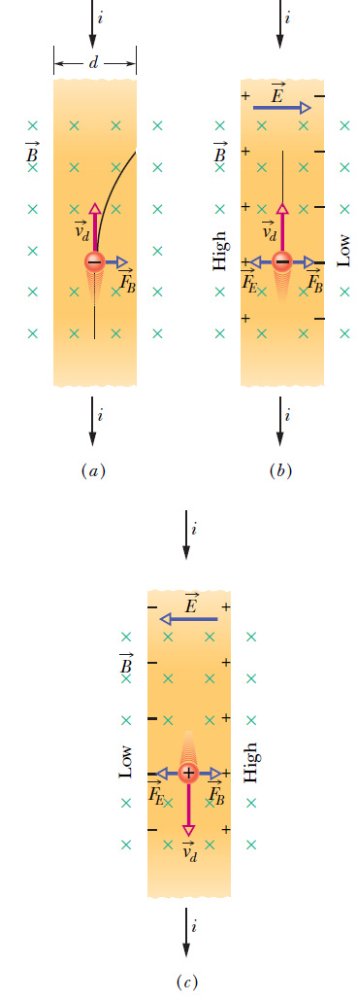



28.5: The Hall Effect:
Fig. 28-8 A strip of copper carrying a current i is immersed in a magnetic field . (a)The situation immediately after the magnetic field is turned on. The curved path that will then be taken by an electron is shown. (b) The situation at equilibrium, which quickly follows. Note that negative charges pile up on the right side of the strip, leaving uncompensated positive charges on the left. Thus, the left side is at a higher potential than the right side. (c) For the same current direction, if the charge carriers were positively charged, they would pile up on the right side, and the right side would be at the higher potential.
A Hall potential difference V is associated with the electric field across strip
width d, and the magnitude of that potential difference is V =Ed. When the electric and magnetic forces are in balance (Fig. 28-8b),
where v_{d} is the drift speed. But,
Where J is the current density, A the cross-sectional area, e the electronic charge, and n the number of charges per unit volume.
Therefore, Here, l=( A/d), the thickness of the strip.

Slide 7
Ampere's Law
The full version of Ampere's Law is one of Maxwell's Equations that describe the electromagnetic force.
Ampere's Law specifically says that the magnetic field created by an electric current is proportional to the size of that electric current with a constant of proportionality equal to the permeability of free space.
Stationary charges produce an electric field proportional to the magnitude of the charge. But moving charges produce magnetic fields proportional to the current (charge and movement).

Slide 8
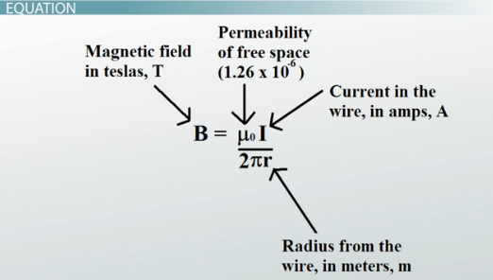
Ampere's Law

Slide 9
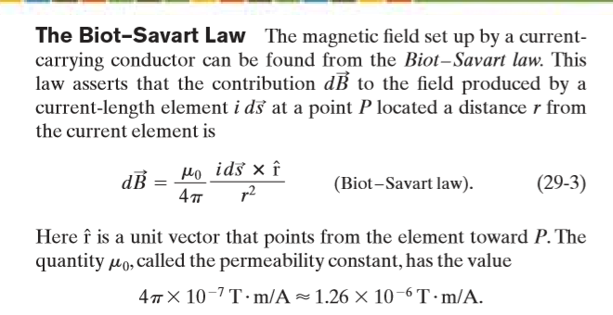

Slide 10
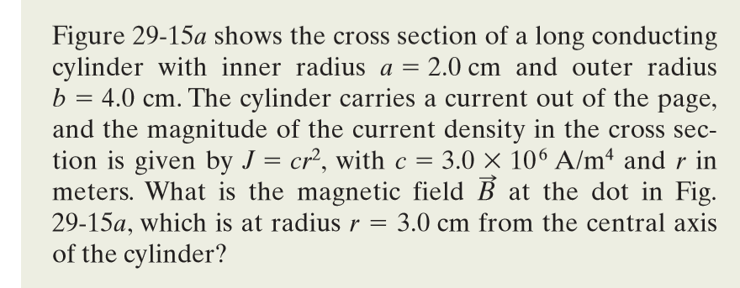
Ampere's Law

